Slide 1
WELCOME TO MY PAGE

Slide 2
TRAVELLING BLOG
PERSONAL WEBSITE

Slide 3
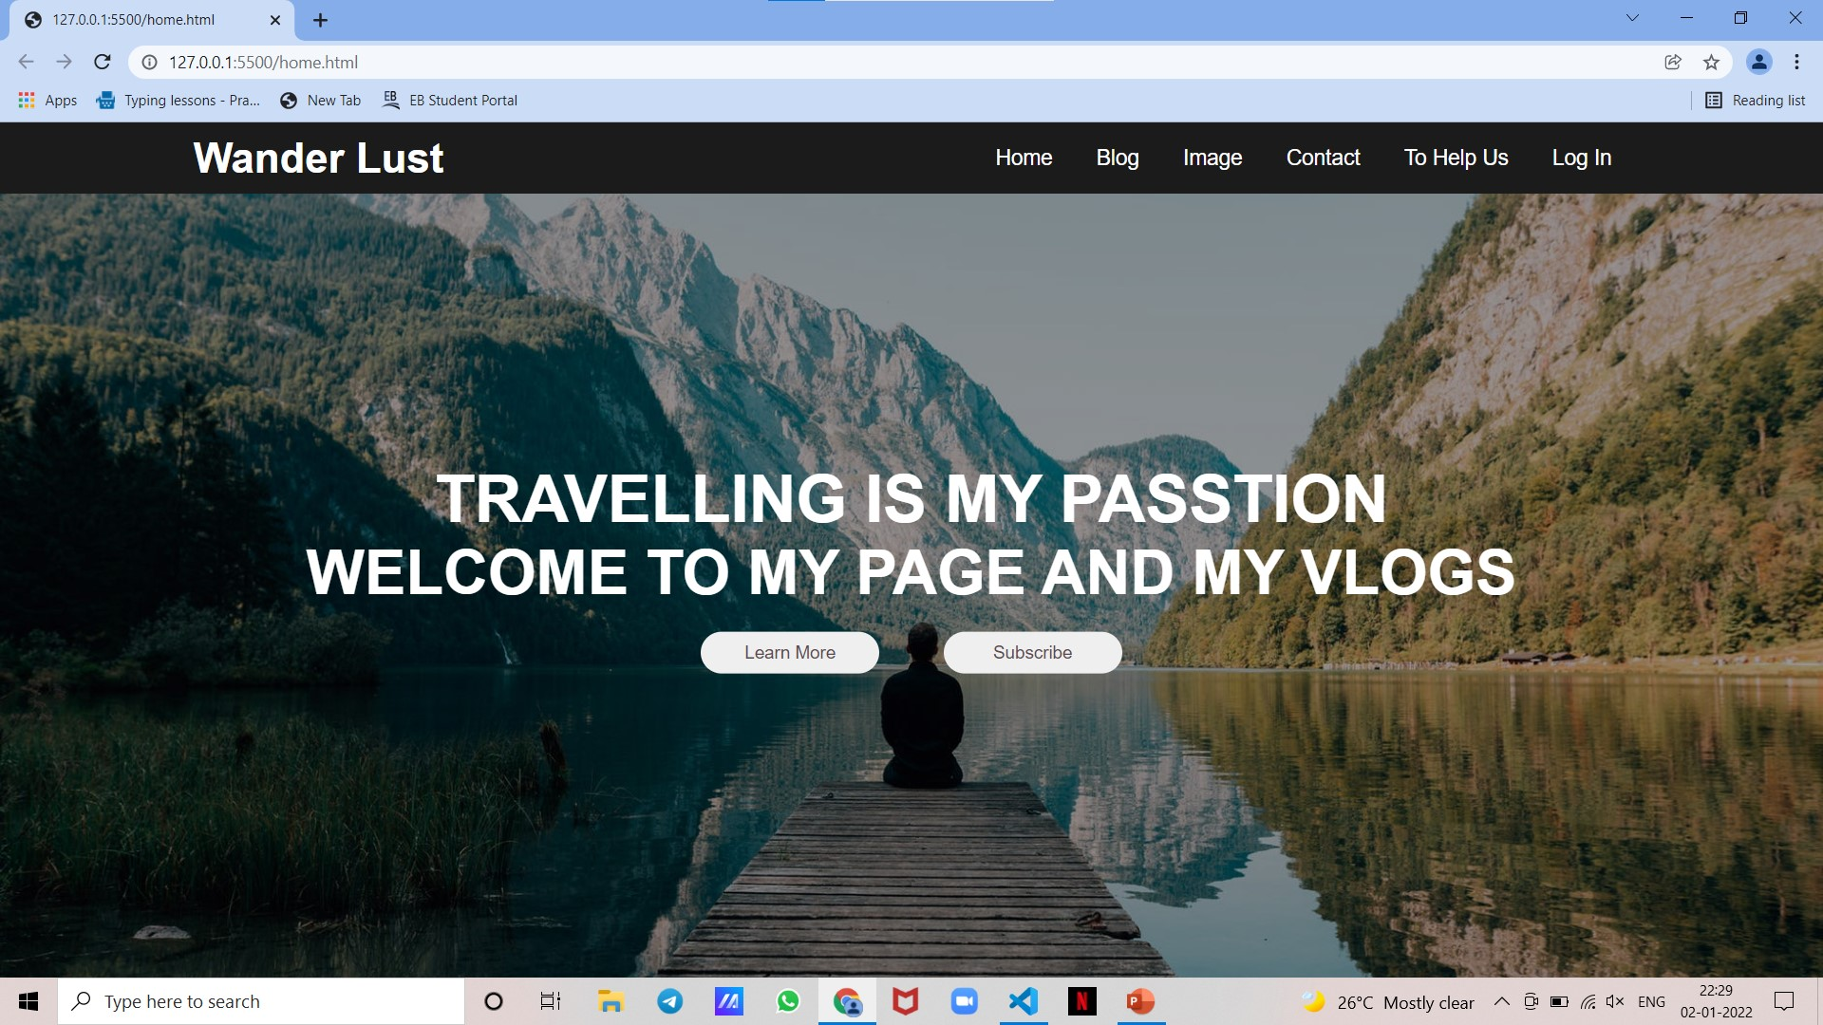
HOME PAGE
IN THIS HOME PAGE . IT CONTAIN THE BASIC INFORMATION NAV LIKE HOME,BLOG,IMAGE,CONTACT,TO HELPS,LOGIN
AND EVERY NAV BUTTON IS NAVIGATE CERTAIN BRIEF INFORMATION AMONG THE PAGE

Slide 4
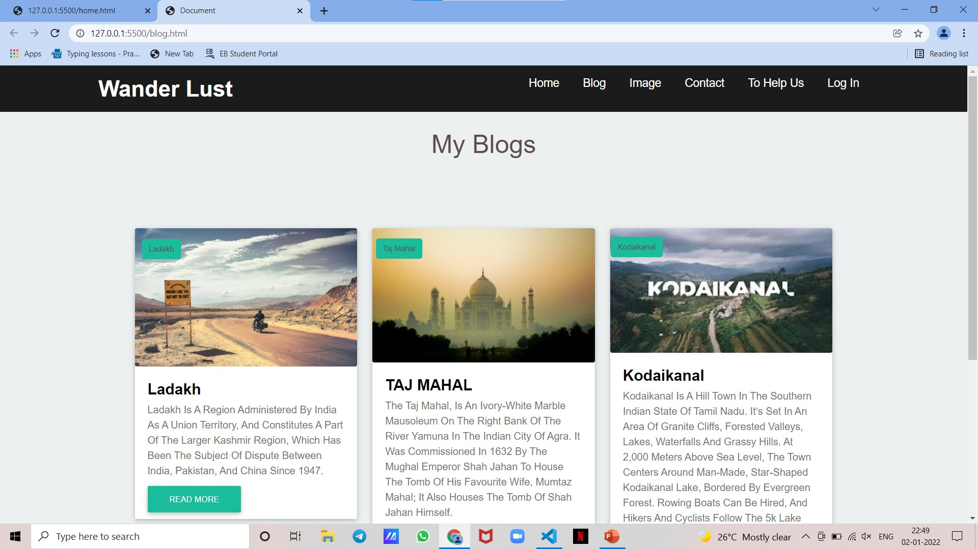
MY BLOGS
IN THIS MY BLOGS SECTION IT CONSITS OF MY OWN EXPERIENCE OF THE I HAVE TO BR VISTIED
AND I DESCRIBED AS MY OWN WAY THIS MY BLOGS SECTION IS I AM SHOW FEW MORE PLACE ONLY IN FUTURE MORE PLACE ARE UPDAED

Slide 5
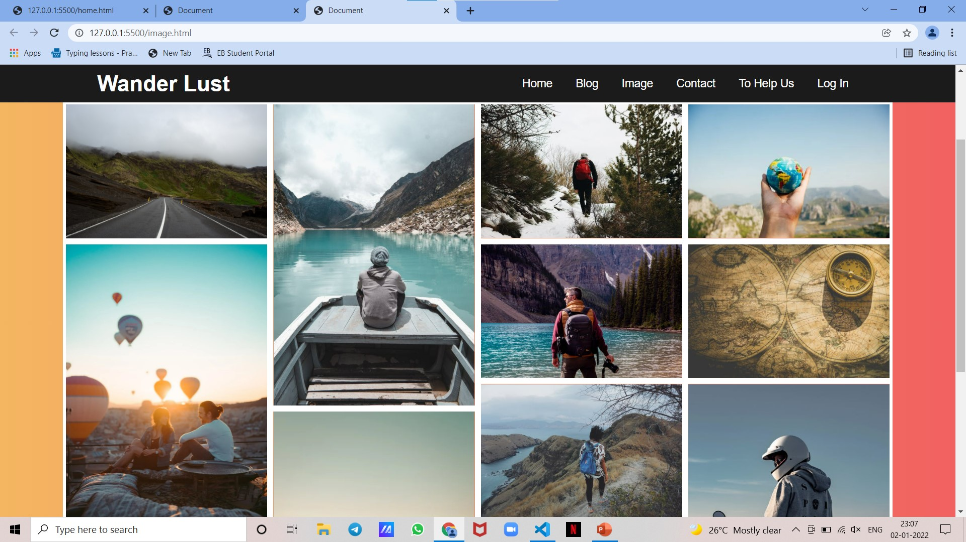
MY GALLERY
IN THIS GALLERY ie;IMAGE SECTION IT CONSIST OF MY TRVELLING PHOTO AND INTERSTING PICTURE
THIS IS THE COOL SECTION FOR ALL I USED TO ZOOM PICTURE HOVER EFFECT IT MADE THE PICTURE ZOOM WHEN YOU HOVER IT

Slide 6
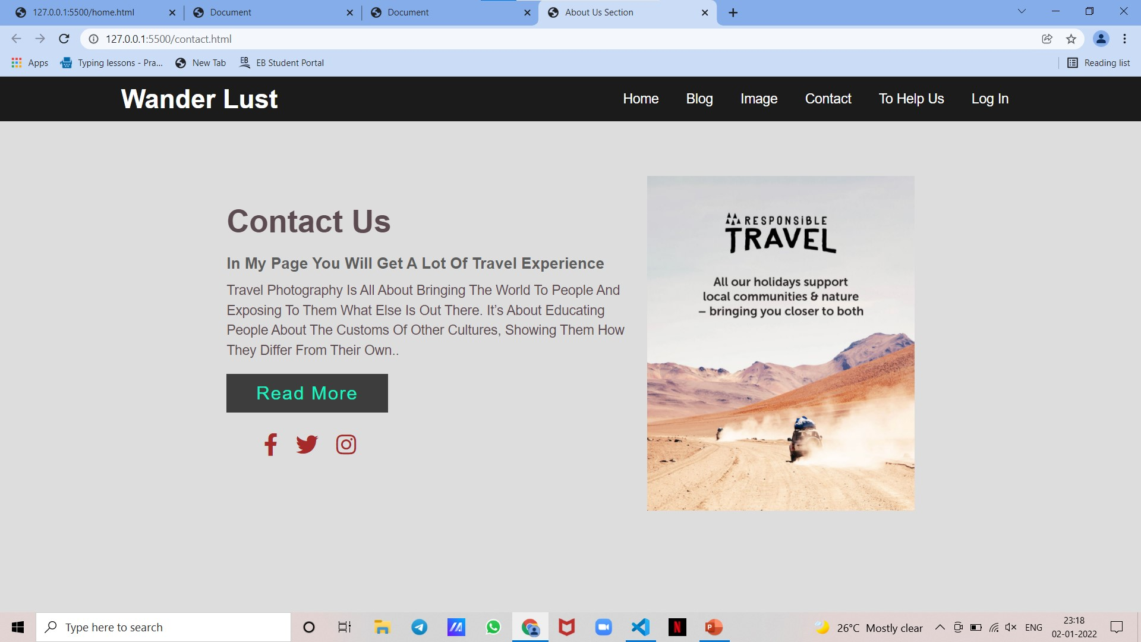
CONTACT US
IN THIS CONTACT SECTION IT CONTAIN OUR SOCIAL MEDIA PLATFORM IF YOU ARE INTRESTED FOLLOW OUR SOCIAL MEDIA PAGE
AND IN THE PAGE IT CONTAIN HOVER EFFECT OF ALL SOCIAL MEDIA ICON AND READ MORE BUTTON AND ATTACHED TRAVELLING PICTURE IT TELLS ABOUT WHAT IS TRAVELLING

Slide 7
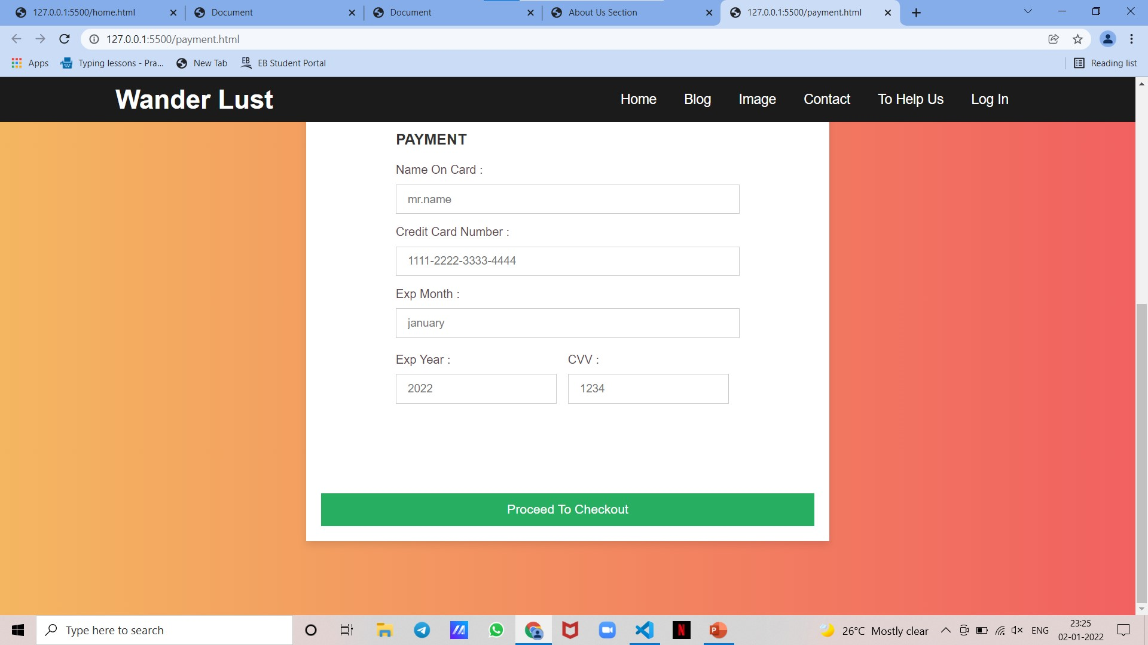
PAYMENT SECTION
IN THIS PAYMENT SECTION IS REALLY HELPFUL TO US AND MOTIVATE TO OUR FUTURE TRAVEL IN THE PAGE CONTAIN SOME VALIDATION OF EMAIL POINT
IF YOU ARE INTRESTED IN OUR PAGE GIVE SUPPORT TO US LIKE FOR GIVING SOME AMOUT TO OUR TRAVEL COMMUNITY THANK YOU

Slide 8
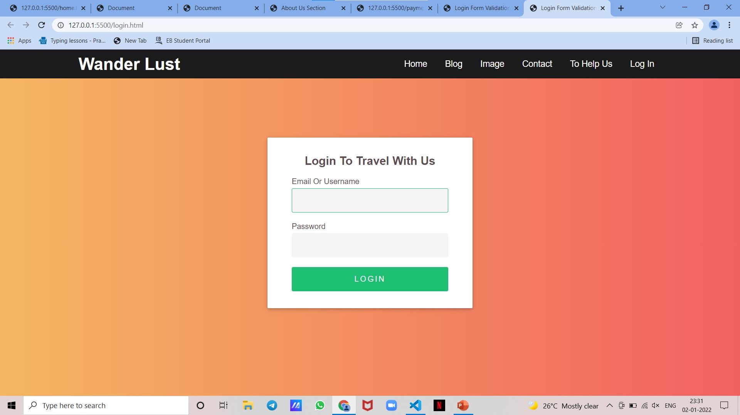
LOGIN SECTION
IF YOU ARE LOGIN TO THE PAGE YOU WILL NEVER MISS ANY FUTURE UPDATE . IN THE VJ TRAVEL COMMUNITY IS THE LARGEST COMMUNITY OF BIKKERS SO THERE IS LOTS OF EVENT DON’T MISS IT LOGIN TO THE PAGE
IN THIS PAGE IS CONTAIN VALIDATION OF USERNAME AND PASSWORD IF YOUR ENTER WORNG CONTENT YOU CAN’T BE LOGIN

Slide 9
THANK YOU
FOR VISTING OUR PAGE

